Slide 1
Software Analysis and Design
Conceptual Models: Behavioural Models
Activity Diagram
Department of Software Engineering,
FAST-NUCES, CFD Campus

Slide 2
Lecture Material
System Analysis and Design in a Changing World (Chapter 5)

Slide 3
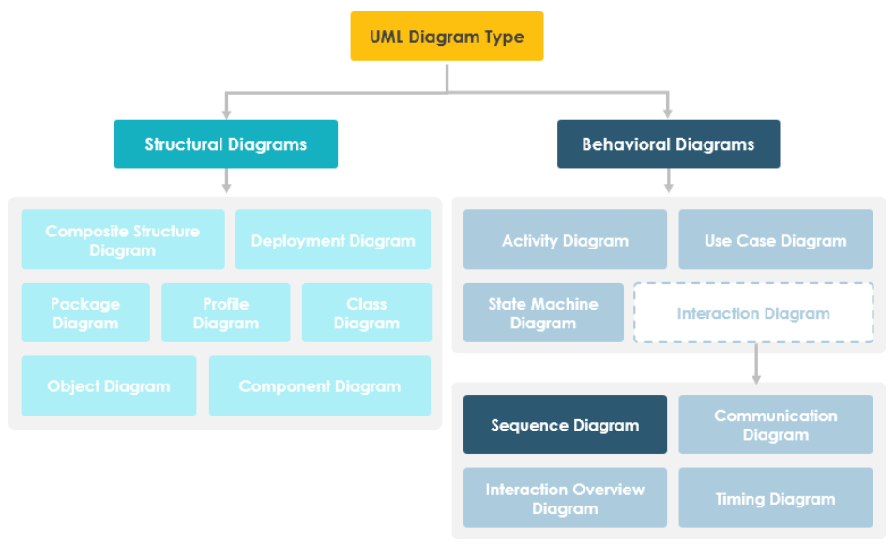
Behavioral Models

Slide 4
Lecture Outline
Behavioral Models
  Use case Diagram
  Activity Diagram
  State Machine Diagram
  Interaction Models
    Communication Diagram
    System Sequence and Sequence Diagram
Already Covered
Will cover in this set of slides

Slide 5
Behavioral Models
Behavioral models are models of the dynamic behavior of a system as it is executing. They show what happens or what is supposed to happen when a system responds to a stimulus from its environment.
You can think of these stimuli as being of two types:
  Data Some data arrives that has to be processed by the system.
    Business systems – Billing system
  Events Some event happens that triggers system processing.
    Events may have associated data, although this is not always the case.
    Realtime systems – Microwave Oven

Slide 6
Behavior Models – Activity Diagram
It is used to model system behavior in the context of data processing.
  Data flow Diagram (DFD) can also be used to fulfill this purpose but DFDs has different rational.
It is a conceptual diagram, used to:
  Model workflows between/within use cases
  Model complex workflows in operations on objects
  Model in detail complex activities in a high level activity Diagram
  Analysis of system requirements, how?
It uses the constructs of flow chart with some other advanced constructs.
It is not directly related to system implementation but helps to improve system understanding.

Slide 7
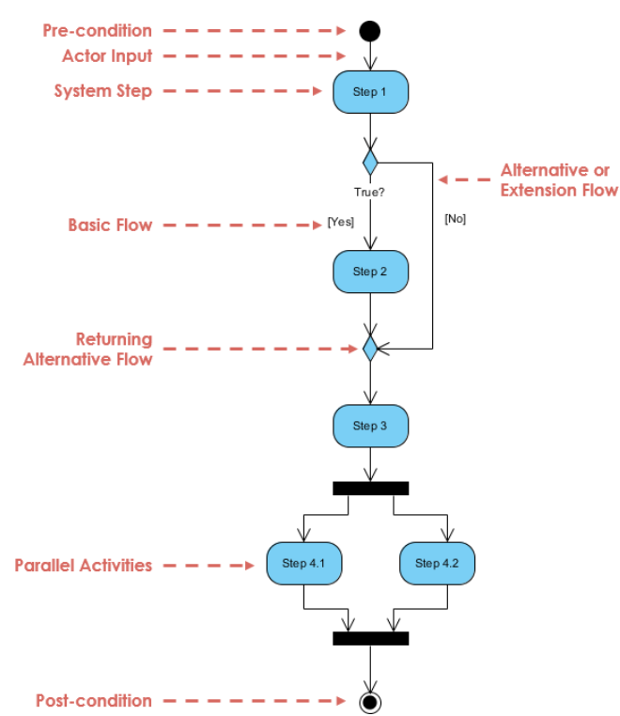
Behavior Models – Activity Diagram
Fork
Join

Slide 8
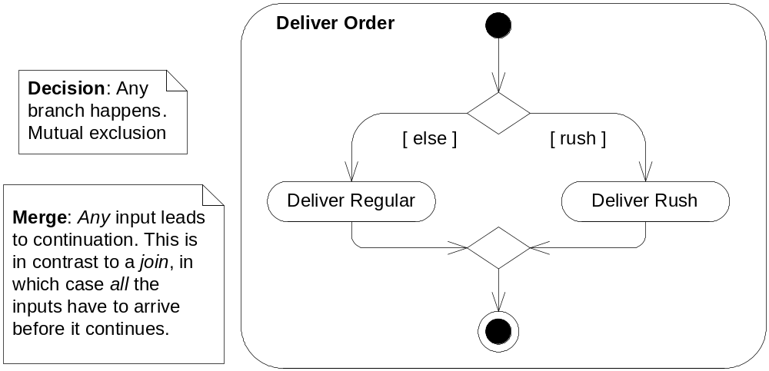
Behavior Models – Activity Diagram

Slide 9
Behavior Models – Activity Diagram
Once the order is received, the activities split into two parallel sets of activities. One side fills and sends the order while the other handles the billing.
On the Fill Order side, the method of delivery is decided conditionally. Depending on the condition either the Overnight Delivery activity or the Regular Delivery activity is performed.
Finally the parallel activities combine to close the order.

Slide 10
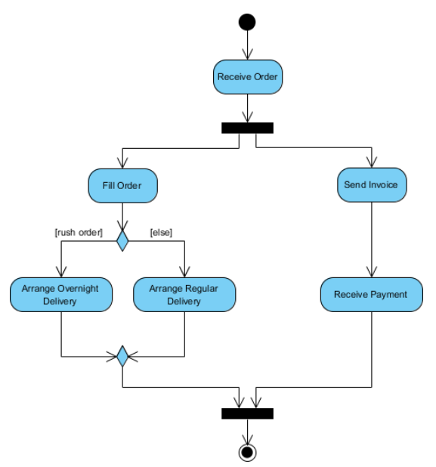
Behavior Models – Activity Diagram

Slide 11
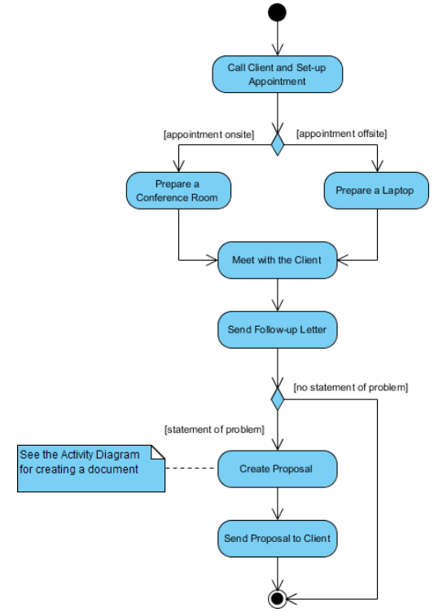
Behavior Models – Activity Diagram
Activity diagram for meeting a new client

Slide 12
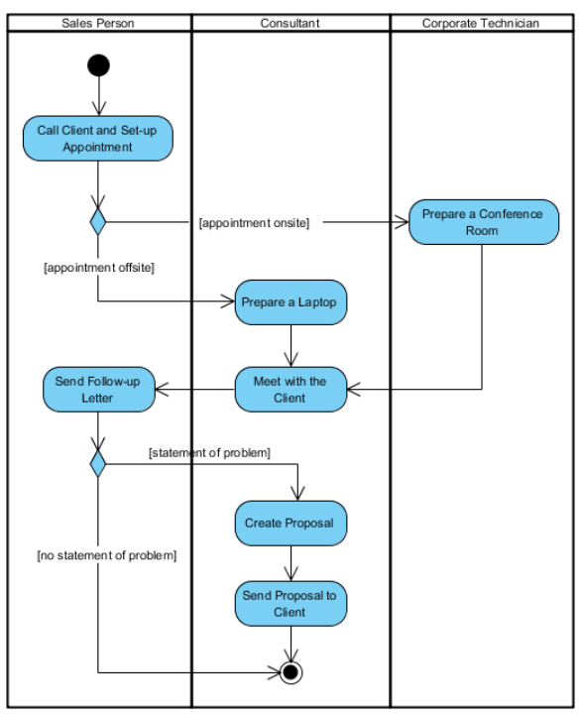
Behavior Models – Activity Diagram
Swimlane
A way to group activities performed by the same actor.

Slide 13
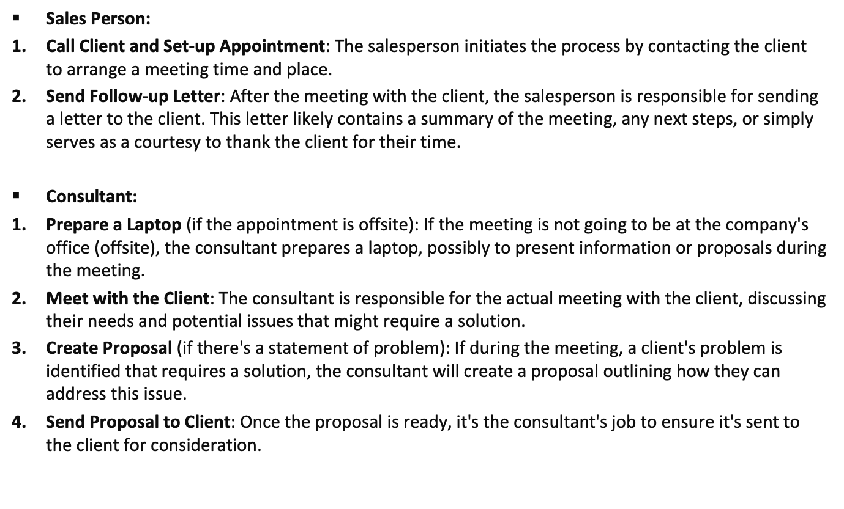
Scenario

Slide 14
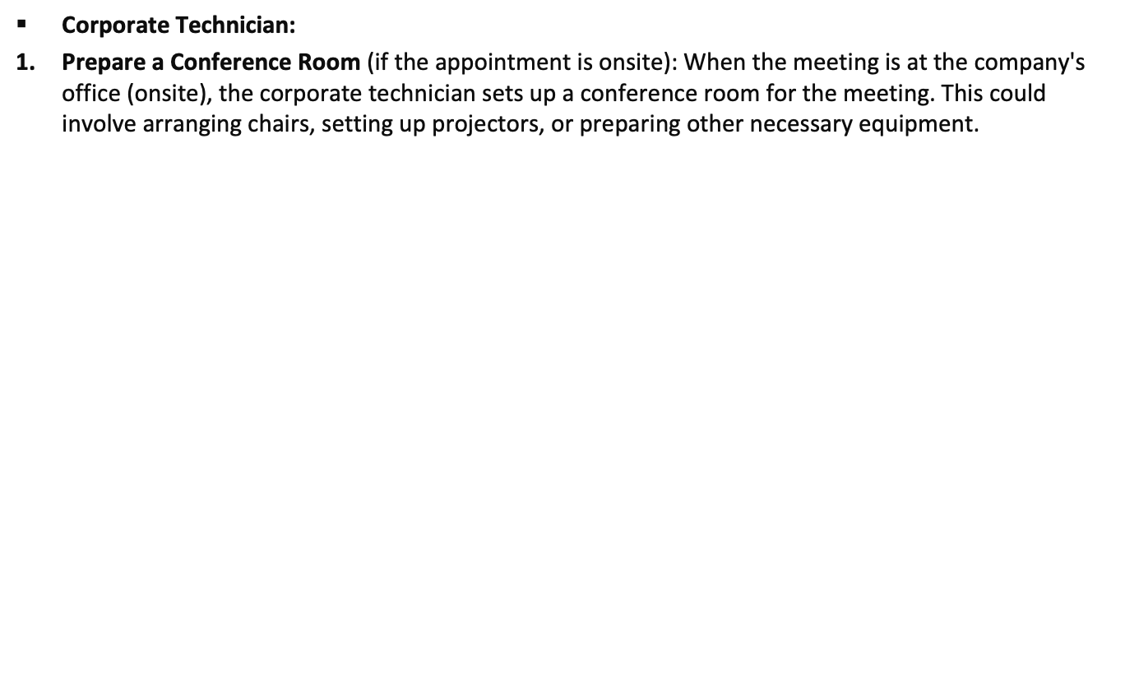
Scenario

Slide 15
Behavior Models – Activity Diagram
Design issues
  We can design activity diagram
    For each use case
    One for the whole system
    One for each user

